Slide 1
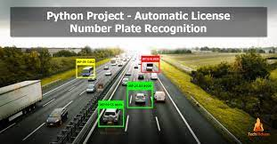
AUTOMATIC NUMBER PLATE RECOGNITION USING IBM CLOUD
Supporting the safety and security of citizens throughout the world

Slide 2
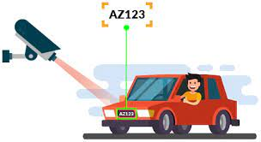
Topics
Introduction
What is ANPR?
How to build ANPR systems ?
Elements
Technology
Working Of ANPR
Advantages
Disadvantages
Steps To Build ANPR Using IBM Cloud
Applications
Conclusion

Slide 3
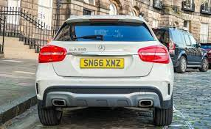
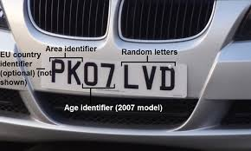
INTRODUCTion
A vehicle registration plate is a metal or plastic plate attached to a motor vehicle for official identification purposes
The license plates are places on the front and back of the vehicle

Slide 4
WHAT IS ANPR ?
Number Plate Recognition System is an image processing technology which uses number (license) plate to identify the vehicle.
Number plate recognition (NPR) can be used in various fields such as vehicle tracking, traffic monitoring, automatic payment of tolls on highways or bridges, surveillance systems, tolls collection points, and parking management systems.
The escalating increase of contemporary urban and national road networks over the last decades emerged the need for efficient monitoring and management of road traffic

Slide 5
How to build ANPR systems
ANPR has two technological issues :
The quality of recognition software with its applied recognition algorithms and the quality of image acquisition technology ,the camera and illumination
The very key factor is the number plate recognition software
A sophisticated recognition software should have the following features :
The highest recognition accuracy
The fastest processing speed
The most type of number plates it can handle
The widest range of picture quality it can handle
The most tolerant against distortions of input data

Slide 6
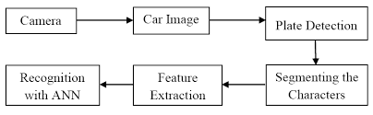
elements
Camera
Illumination
Frame grabber
Computer
Hardware
Software
Database

Slide 7
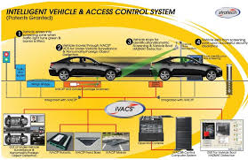
Variuos names of technologies
License plate recognition
Car registration system
Intelligent transport system
Access control

Slide 8
ANPR equipment
ANPR systems consists of : hardware and software.
ANPR HARDWARE | ANPR SOFTWARE
CAMERA SYSTEM | 1.application
2.COMPUTER | 2.Software package
3.FRAME GRABBER | 3.DLL
4.TRIGGER | 4.Data base

Slide 9
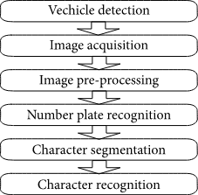
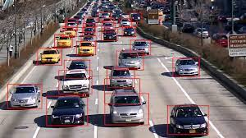
Working of anpr
The ANPR is divided into three steps.
detection of vehicle
Capture of images
Process of recognition

Slide 10

advantages
Adds security
Automated service
Real-time benefits
Privacy concerns
Extreme circumstances

Slide 11
disadvantages
A disadvantage of ANPR parking systems is that they rarely take into account human error and behaviour. ANPR systems do not usually consider giving a grace period when you enter a car park
The technology often uses low resolution images for which the images are actually not visible in every case

Slide 12


Steps to build ANPR using IBM cloud
Rapid API account creation
Testing the endpoint via system console
Building a flask application
Deploy in IBM cloud

Slide 13
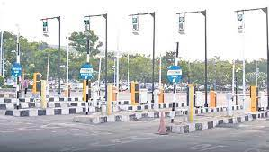

applications
Parking
Access control
Tolling
Border control
Stolen cars
Traffic control

Slide 14
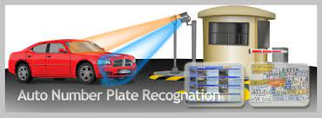
conclusion
There is a immediate need of such kind of Automatic Number Plate recognition system in India as there are problems of traffic,stealing vehicles ..etc
Government should take some interest in developing this systems as this system is very economical and eco-friendly,if applied effectively
This change will help in the progress of nation

Slide 15
TEAM:EEE-004
Thank you
TEAM MEMBERS : L.SONY
M.BHAVANA
G.ABHLIASH
N.ANIL KUMAR

